Slide 1
Robot fencing with motion sensor camera - 6

Slide 2
Robot fencing with motion sensor camera
Expectation:
Need a device to detect the entry of a person into a hazardous area and slow or stop Robot
To prevent unauthorised access, installed press. Mat outside the robo work envelop that which can sense when a person step on it
.
.
Problem Statement :
Most injuries occur not only during normal operation but also during times when human interaction is most prevalent.
Programming , testing , inspection and repair by system design robots rarely need human interaction during normal use and operation which causes hazardous accidents to personnel.
Output:
To avoid the chances of occurring hazardous accidents by mean of installing a sensor.
AI model has to detect if any abnormity inside the Cage
Supervisor:
Raunak Ujawane
Ass. Mng- Quality
raunak.ujawane@dana.com
+91-7026107775
Leader Name:
Damini Narkhede
GET
damini.narkhede@dana.com
9420470552
Timeline
Data collection and sorting
28st Aug
Analysis
4th sept
Implementation
11rd sept
Final performance analysis
18th sept
Final report drafting
25th Sept
Collection of data.
Listing different. Devices(sensors)
Data visualization.
standardising data.
Sensor installation
Checking the performance

Slide 3
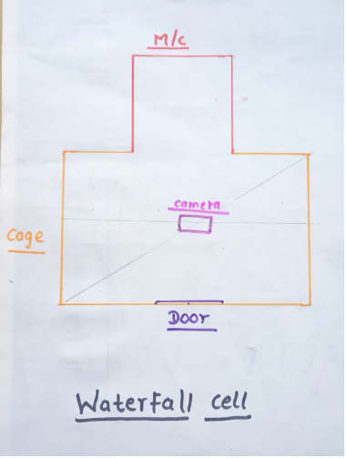
[ Details]
Product- Waterfall Part No- 6-40-1697
[ Process flow]
[Requirements ]
Camera – 1 On Top of Cell PC setup – Available Camera Holder-1

Slide 4


